Slide 1
News Tone
Master of Computing and Innovation Project 2020
Team 23
a1733905 Ying Wang
a1736798 Yiru Li
a1758331 Jin Zhou

Slide 2
What do we do?
Topic: news tone
Analysing and classifying the historical data of the site for a given period.
Goals:
Developing a program that can identify the sentiment – positive or negative – of a front page of a web site.
This program would be able to display analysis results on a dashboard/graph, which can make the results easy to view.

Slide 3
Why do we do this?
It’s impossible to get emotional information from huge web pages manually.
The sentiment tendencies of web pages could be utilized in many practical areas.
Assisting the financial sector to adopt appropriate strategies to deal with market panics.
Helping relevant stakeholders to avoid huge loss of wealth.
Provide a scientific basis for the strategic decision direction of the government and enterprises.

Slide 4
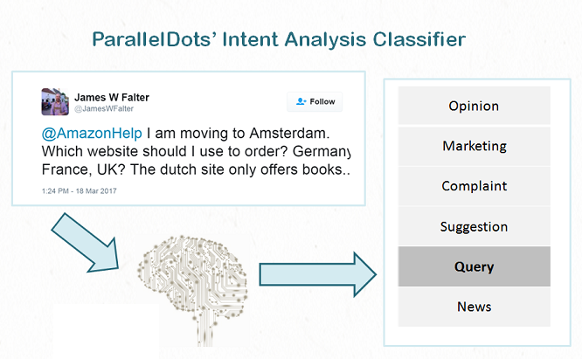
Example of sentiment analysis application Users’ intensions - Twitter
Text classifier is the foundation of sentiment analysis.
Intension, concern, feeling.
Different strategy for certain category.

Slide 5
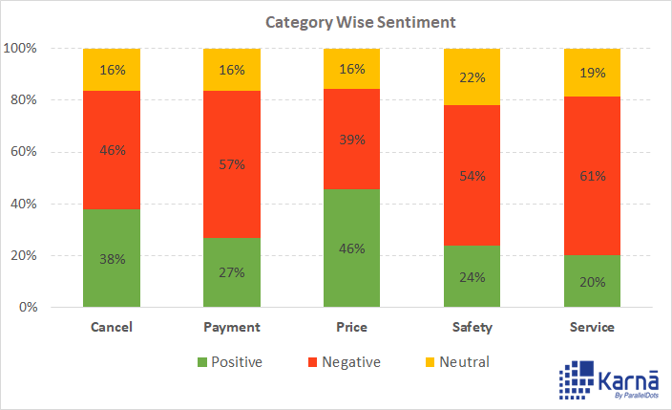
Example of sentiment analysis application Uber - Facebook
Text classifier algorithm classifies info in certain categories.
Random content contains junk/unrelated/spam content.

Slide 6
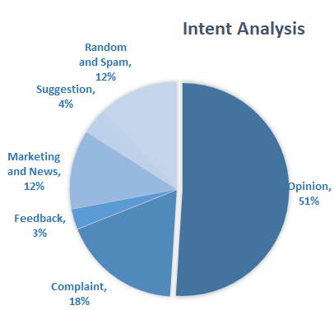
Example of sentiment analysis application Uber - Facebook
Assist removing irrelevant intent categories.
Improve accuracy of algorithm.

Slide 7
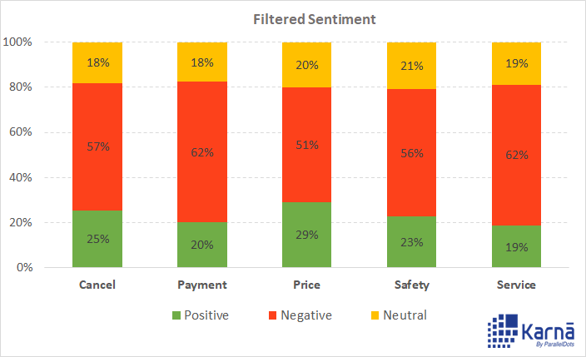
Example of sentiment analysis application Uber - Facebook
Positive price related comments dropped from 46% to 29%.
The trend regard for price is negative.
Strategies are needed to avoid declines.

Slide 8
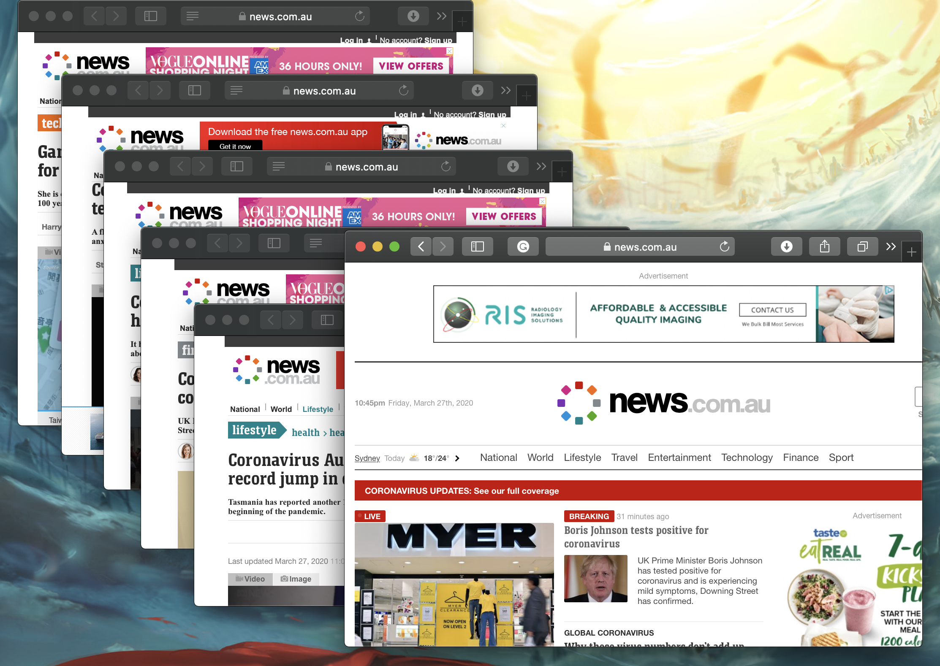


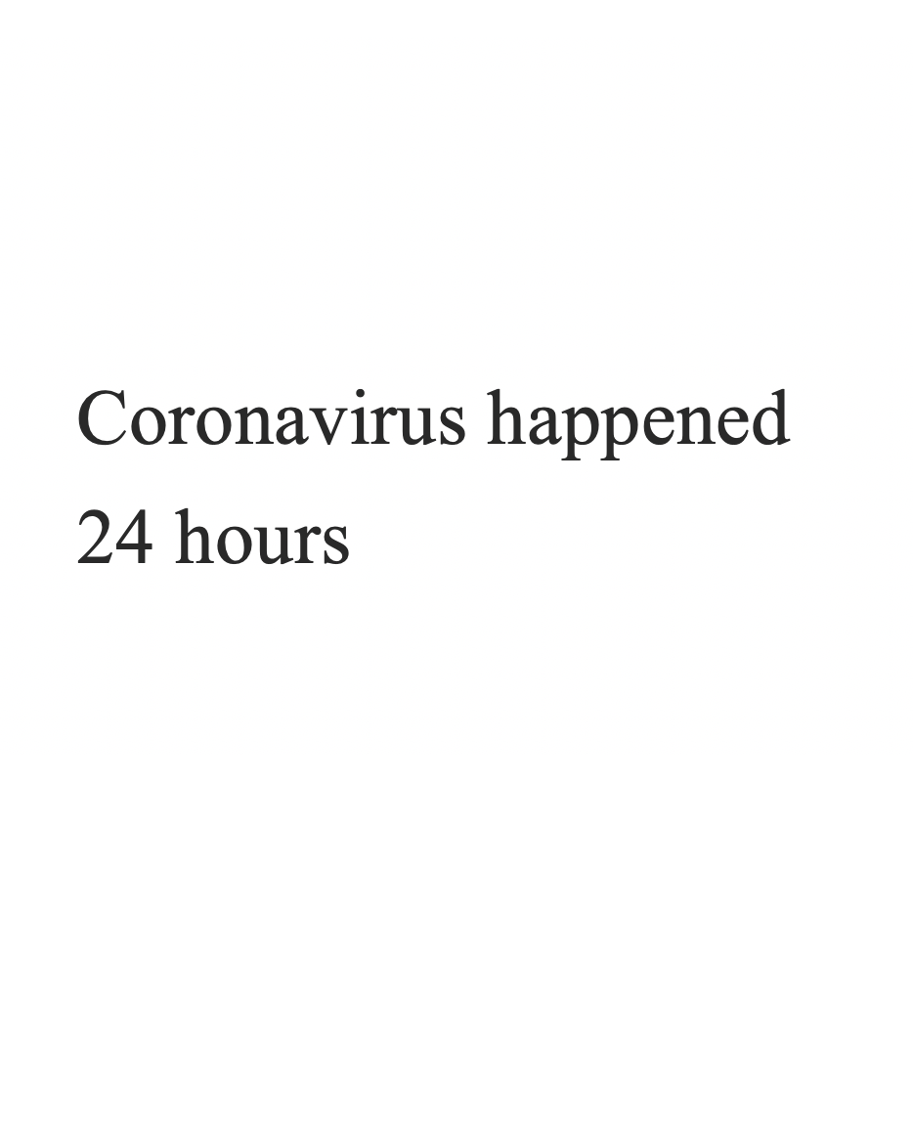
How to implement It?
Step 1：Extracting article titles on the front page of the website – news.com.au – as raw data.
Step 2：Filtering out the structural words in the article titles.

Slide 9
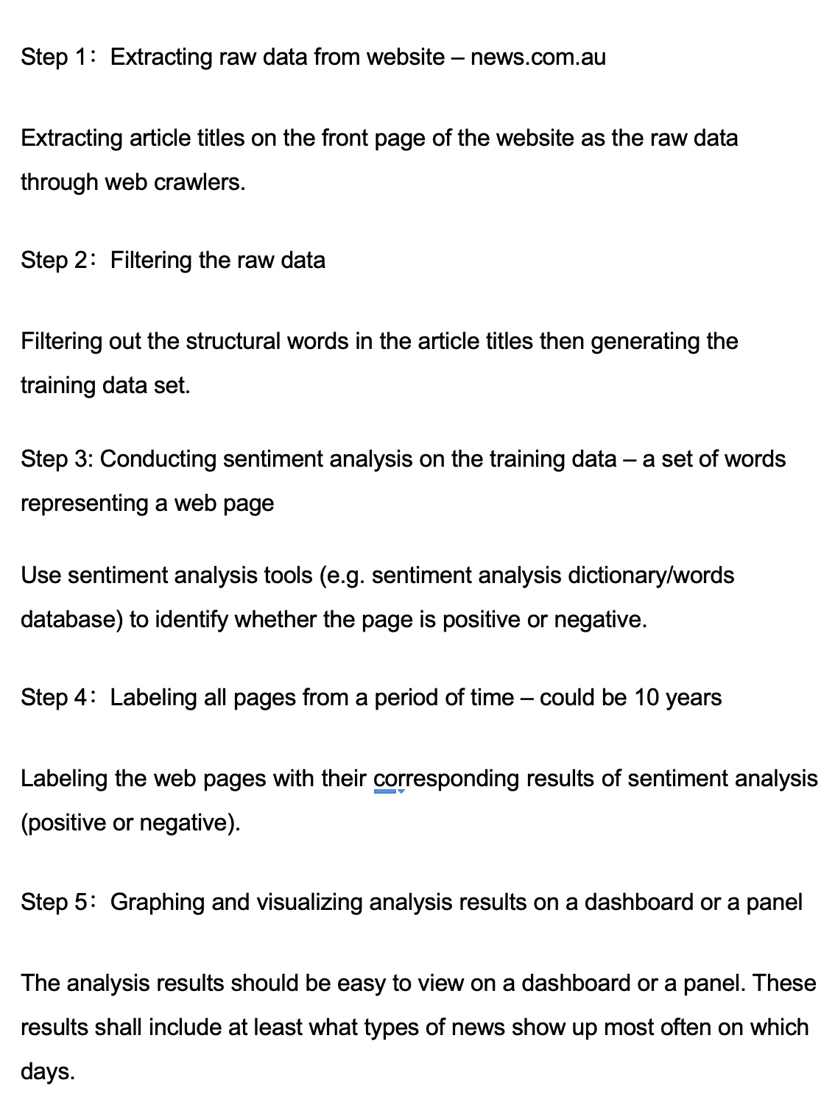
How to implement It? - continue
Step 3: Use sentiment analysis tools (e.g. sentiment analysis dictionary/words database) to identify whether the page is positive or negative.
Sentiment analysis tools
Positive
or
Negative

Slide 10
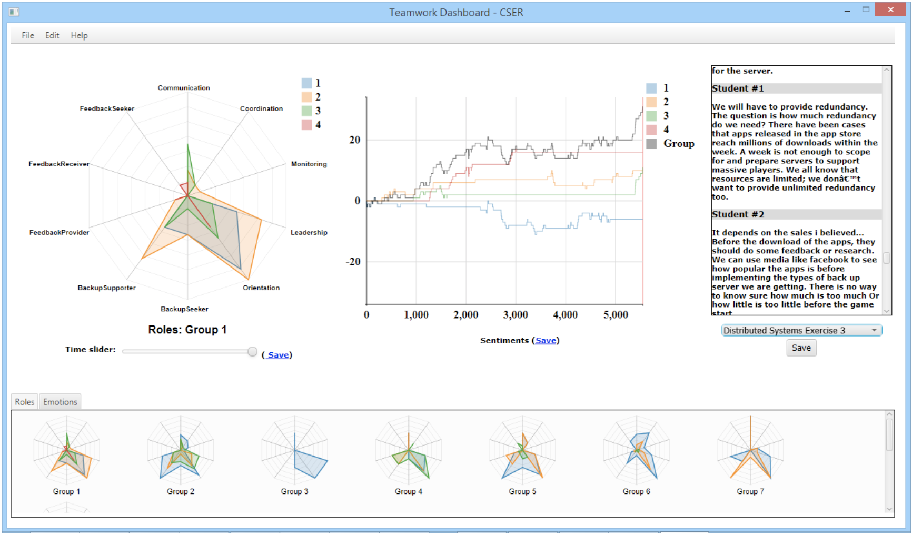
How to implement It? - continue
Step 4：Labeling the web pages with their corresponding results of sentiment analysis (positive or negative).
Step 5：Graphing and visualizing analysis results on a dashboard
Making the analysis results easy to view on a dashboard. (e.g. What types of news show up most often on which days.)
Figure 1. Example of a dashboard (Tarmazdi H et al. 2015)

Slide 11
Reference
Tarmazdi H et al. 2015, Using learning analytics to visualize computer science teamwork’, paper presented at ResearchGate, The University of Adelaide, 19 November.

